Slide 1
UIT2201 – Programming and Data Structures
Tree ADT

Slide 2
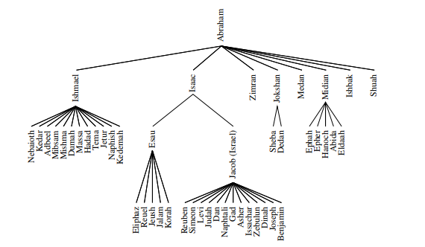
General Trees
Nonlinear data structures
The relationships in a tree are hierarchical, with the terms “parent,” “child,” “ancestor,” and “descendant” being the most common words used to describe relationship

Slide 3
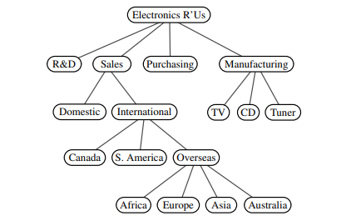
Tree Definition
A tree is an abstract data type that stores elements hierarchically.
Except for the top element, each element in a tree has a parent element and zero or more children elements.

Slide 4
Formal Tree Definition
Formally, we define a tree T as a set of nodes storing elements such that the nodes have a parent-child relationship that satisfies the following properties:
If T is nonempty, it has a special node, called the root of T, that has no parent.
Each node v of T different from the root has a unique parent node w; every node with parent w is a child of w
Two nodes that are children of the same parent are siblings.
A node v is external if v has no children. External nodes are also known as leaves
A node v is internal if it has one or more children.

Slide 5
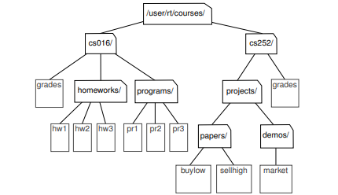
Edge and path of tree
An edge of tree T is a pair of nodes (u,v) such that u is the parent of v, or vice versa.
A path of T is a sequence of nodes such that any two consecutive nodes in the sequence form an edge, contains the path (cs252/, projects/, demos/, market).

Slide 6
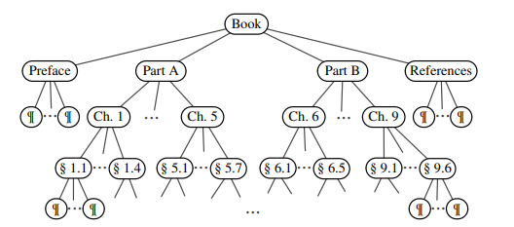
Ordered Trees
A tree is ordered if there is a meaningful linear order among the children of each node; that is, we purposefully identify the children of a node as being the first, second, third, and so on.
Such an order is usually visualized by arranging siblings left to right, according to their order

Slide 7
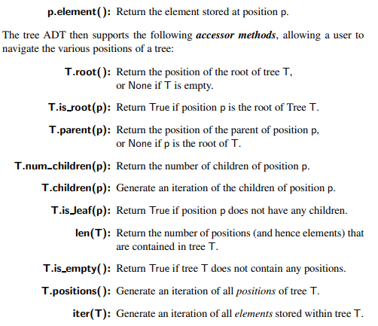
Tree Abstract Data Type
Define a tree ADT using the concept of a position as an abstraction for a node of a tree. An element is stored at each position, and positions satisfy parent-child relationships that define the tree structure. A position object for a tree supports the method:

Slide 8
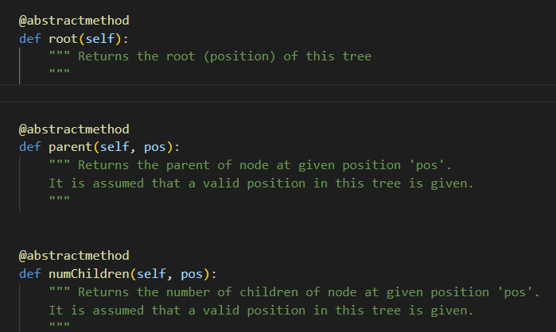
A Tree Abstract Base Class

Slide 9
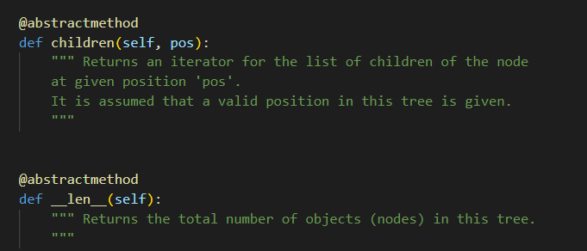
A Tree Abstract Base Class (contd..)

Slide 10
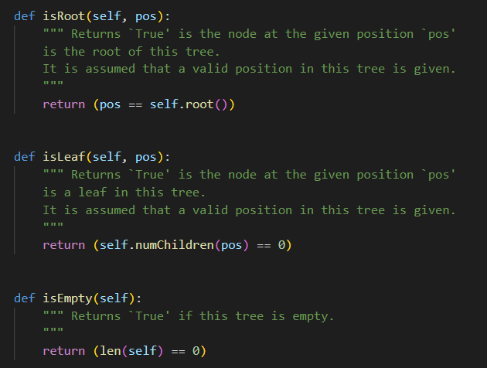
Tree ADT Concrete methods

Slide 11
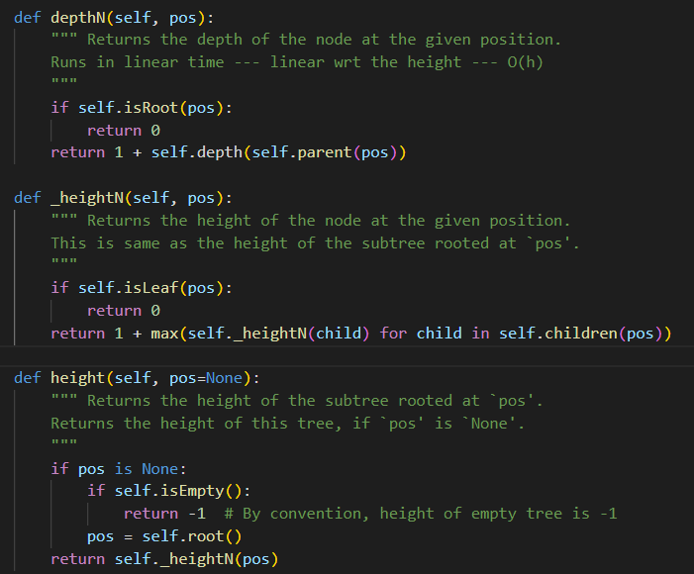
Tree ADT Concrete methods (contd..)

Slide 12
Binary Trees
A binary tree is an ordered tree with the following properties:
Every node has at most two children.
Each child node is labeled as being either a left child or a right child.
A left child precedes a right child in the order of children of a node. The subtree rooted at a left or right child of an internal node v is called a left subtree or right subtree, respectively, of v.

Slide 13

Proper Binary Tree
A binary tree is proper if each node has either zero or two children. Some people also refer to such trees as being full binary trees. Thus, in a proper binary tree, every internal node has exactly two children.
A binary tree that is not proper is improper

Slide 14
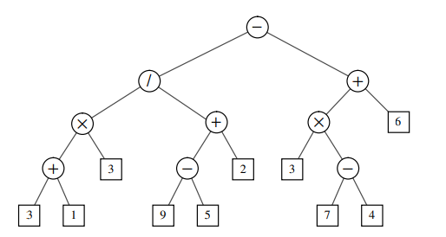
Expression Tree

Slide 15
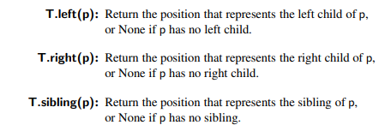
Binary Tree Abstract Data Type
As an abstract data type, a binary tree is a specialization of a tree that supports three additional accessor methods:

Slide 16
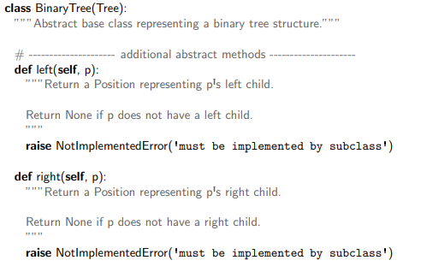
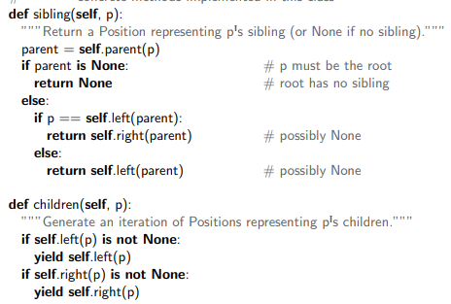
Binary Tree Abstract Base Class in Python

Slide 17
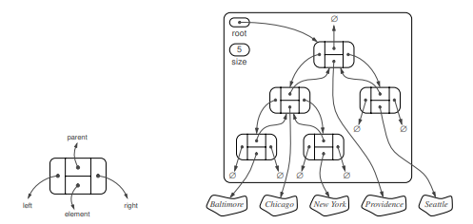
Linked Structure for Binary Trees

Slide 18
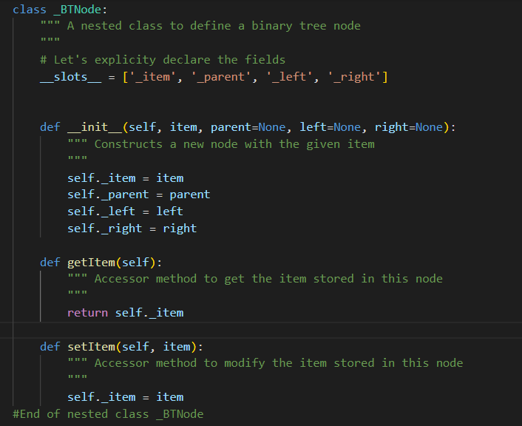
Binary Tree Node

Slide 19
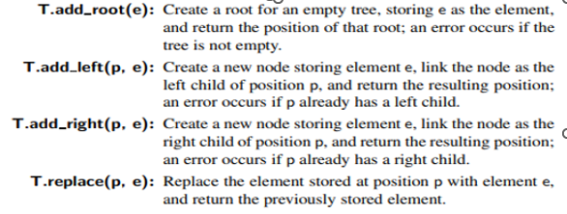
Operations for Updating a Linked Binary Tree

Slide 20
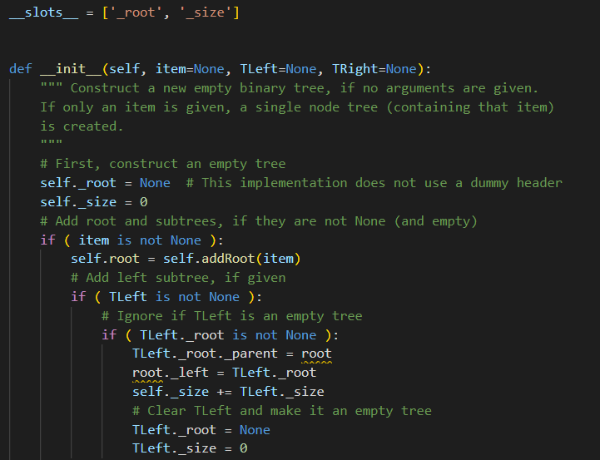
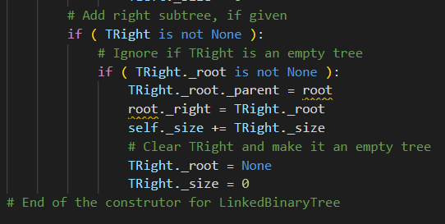
Linked Binary Tree constructor

Slide 21
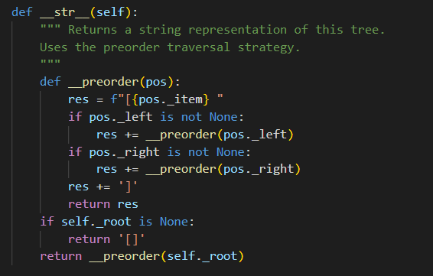
Preorder Traversal

Slide 22
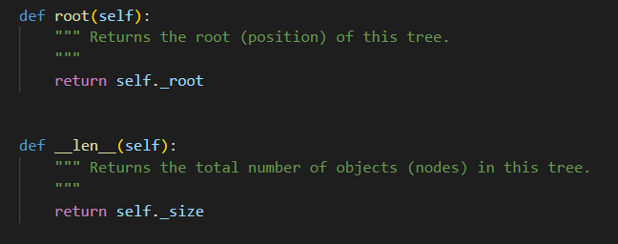
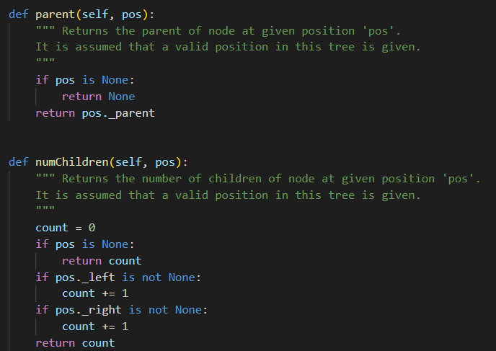
Linked Binary Tree concrete methods

Slide 23
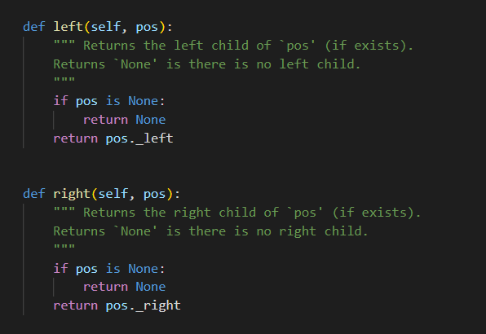
Left and right methods

Slide 24
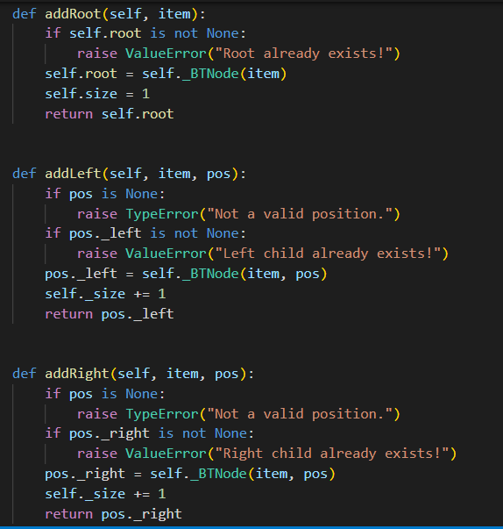
AddRoot, AddLeft and AddRight methods

Slide 25
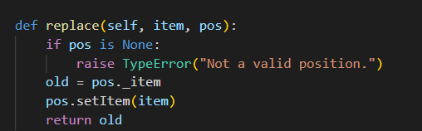
Replace method

Slide 26
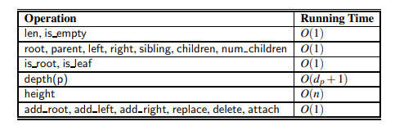
Performance of the linked structure implementation of a binary tree.

